Slide 1

Credit Card Fraud Detection project
Presented by:-
Guided by:-
Valiveti Manikanta Bhuvanesh-19BCD7088
Tarini Guttula -19BCE7758
Popuri Harsha Vardhan -19BCI7039
G.Balasubramanyam -19BCE7681
Rokkam Anirudh -19BCD7081
Dr.GopiKrishnan

Slide 2
ABSTRACT
Credit card fraud has increased dramatically in recent months. It is, in fact, one of the most common threats facing the BFSI industry. The objective of this R project is to create a classifier capable of accurately detecting credit card fraud. The credit card transaction dataset with a mix of non-fraudulent and fraudulent transactions will be used for research. Decision trees, logistic regression, artificial neural networks and the gradient classifier will be used in the project. a fraudulent and non-fraudulent call by applying these ML algorithms.This project will show you how to classify data using machine learning techniques in a real context.

Slide 3
INTRODUCTION

Slide 4
ABOUT DATASET
Transactions by European cardholders in September 2013 are included in this dataset. There are 492 fraudulent transactions out of a total of 2.84.807. As there are fewer fraud cases than transactions, the data is out of balance. The dataset has been transformed into a PCA transformation and includes only numeric values. For the sake of privacy and confidentiality, many basic details are hidden, simply leaving the converted PCA data.Only time and money are not converted into PCA; all other values ​​provided (v1, v2, v3, v4, v5, v6, v7, v8, etc.) are PCA transformed numeric values. The fraudulent entity class has a value of 1 and the regular transaction has a value of 0.

Slide 5
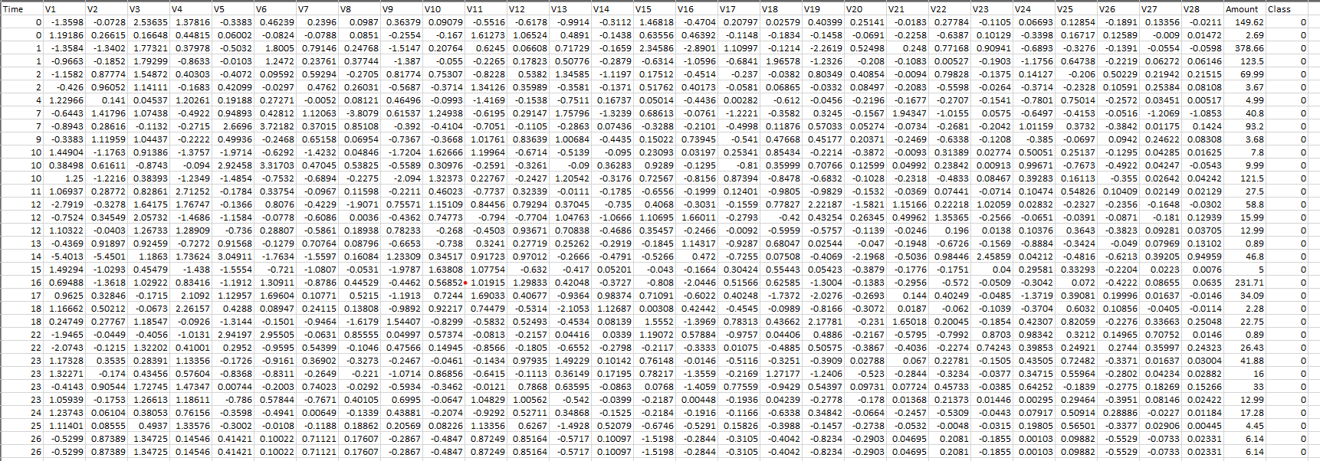
DATASET

Slide 6
PROCEDURE

Slide 7
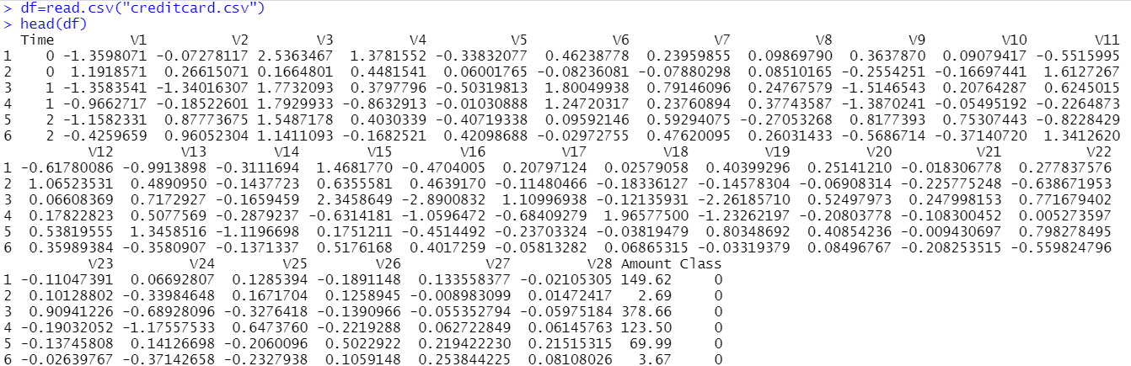
Step1:Loading dataset
We import datasets containing credit card transactions

Slide 8
Step 2:Data Exploration
In this step of the fraud detection ML project, we are able to discover the information this is contained withinside the credit score card information. We will continue through showing the credit score card information the usage of the head() feature in addition to the tail() feature. We will then continue to discover the opposite additives of this data frame.

Slide 9
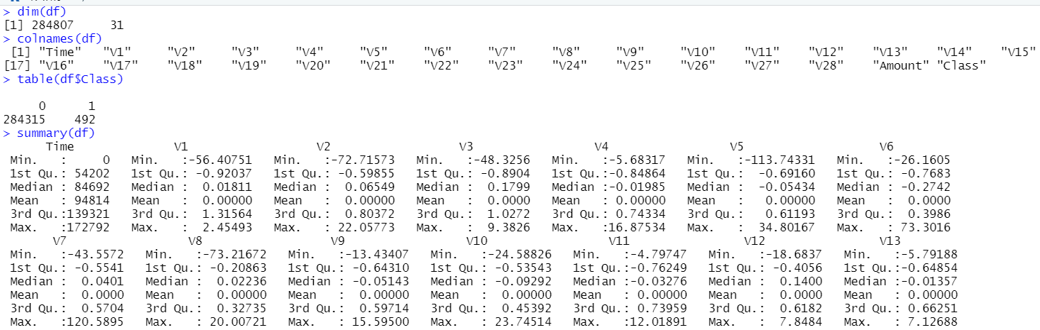
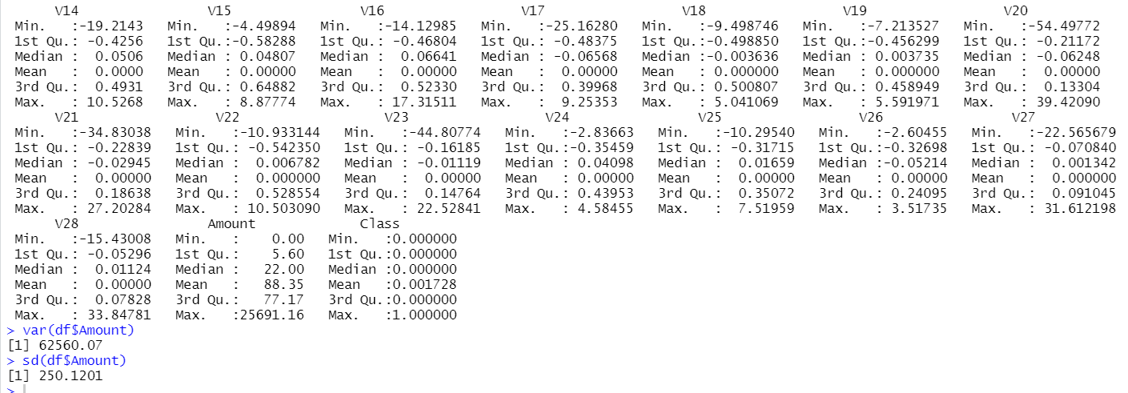

Slide 10
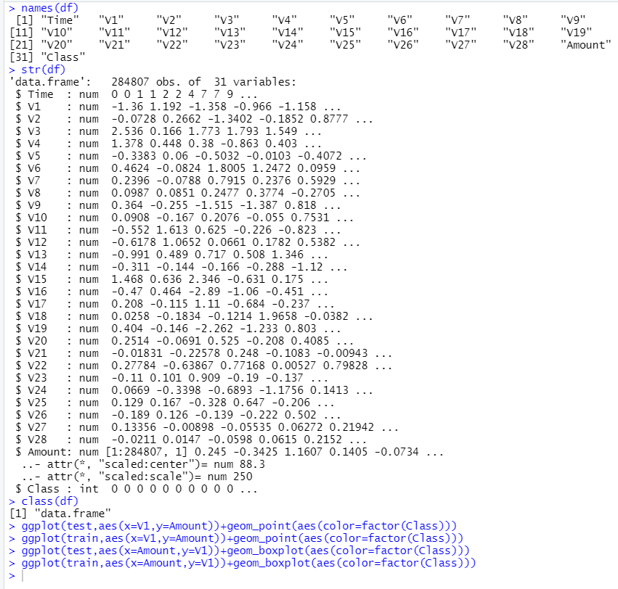
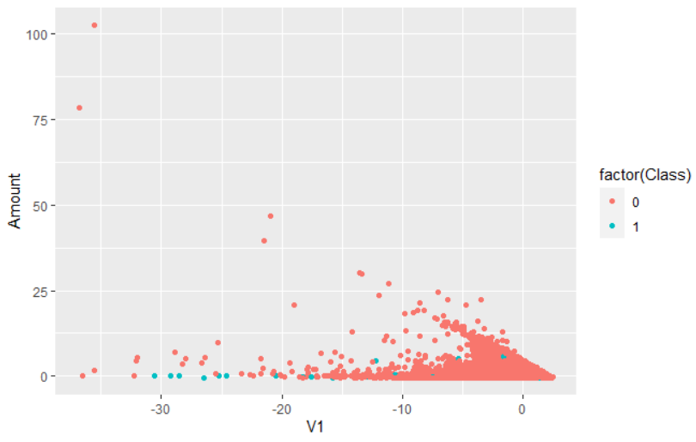
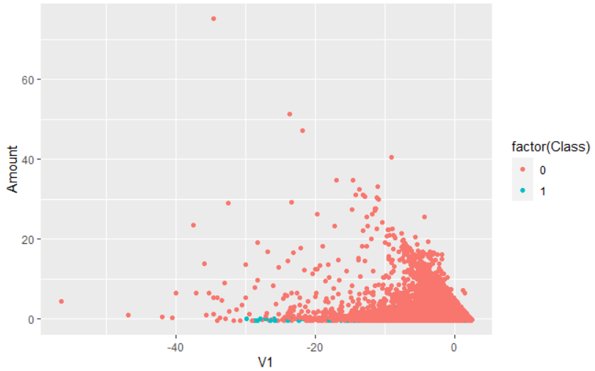
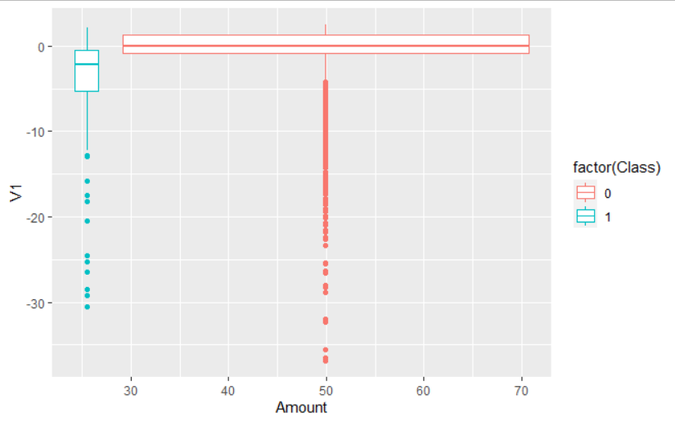
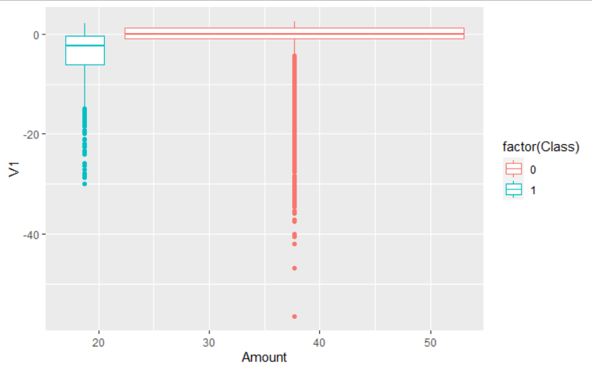

Slide 11
Step 3 :Data Manipulation
In this step, we'll scale our data using the scale () function. We will apply this to the amount component of the amount of our credit card information. Scaling is also known as feature normalization. Using scaling, data is structured according to a specified range. Therefore, there are no extreme values ​​in our dataset that could interfere with the functioning of our model.

Slide 12
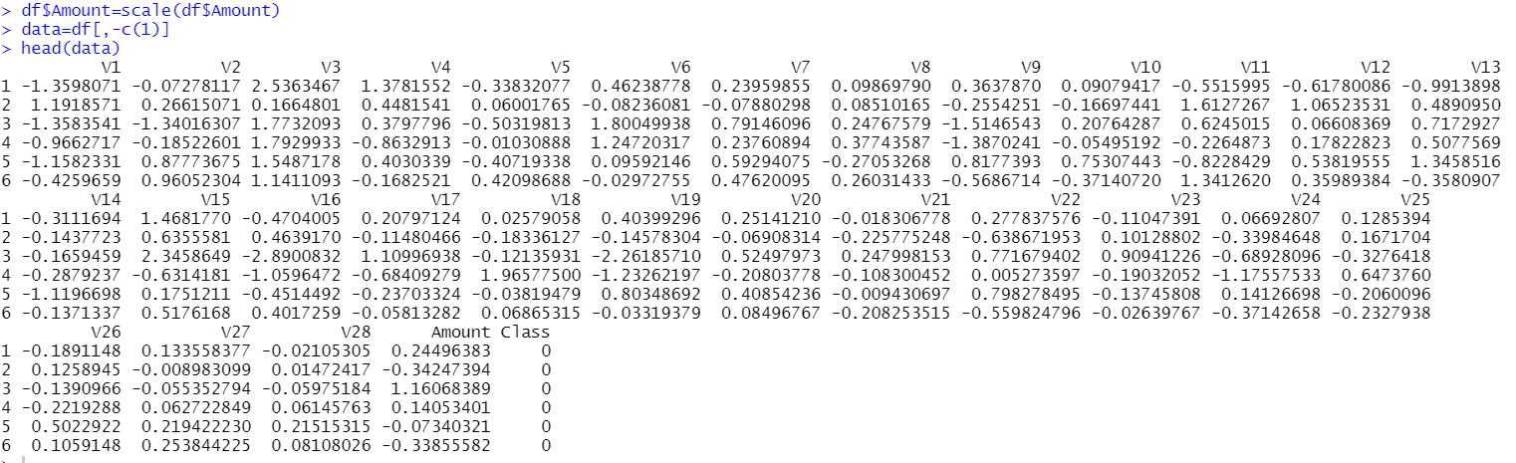

Slide 13
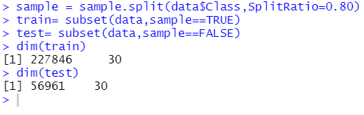
Step 4 :Data Modeling
Once we have standardized the dataset, we will divide our dataset into training sets and test sets with a divide ratio of 0.80. This means that 80% of our data will be attributed to train data while 20% will be attributed to test data.

Slide 14
Fitting Logistic Regression Model
In this section , we will adapt our first model. We will start with the logistic regression. Logistic regression is used to model the probability of a class outcome as pass / fail, pass / fail, and in our case - fraud / non-fraud. We are implementing this model on our test data.

Slide 15
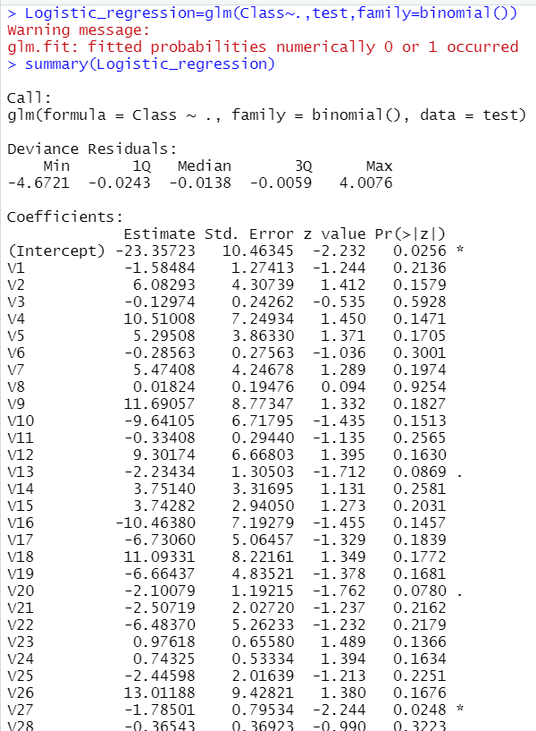

Slide 16
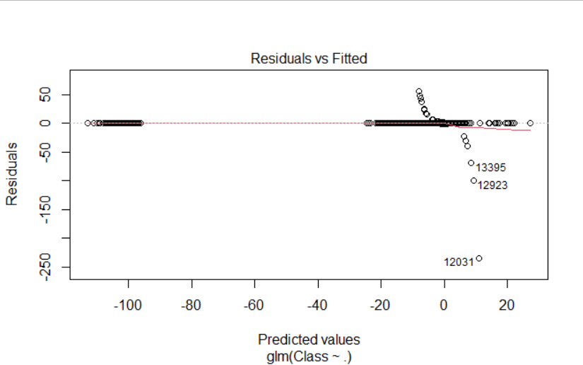
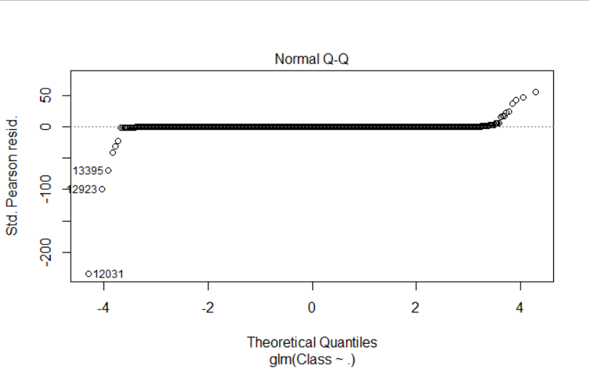
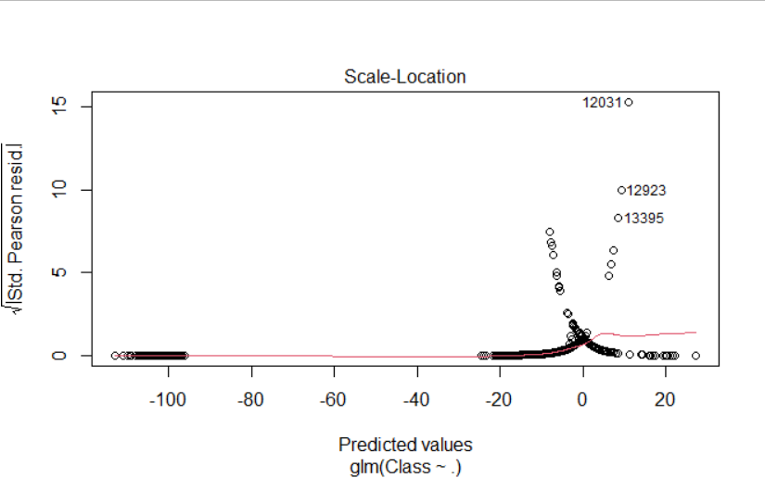
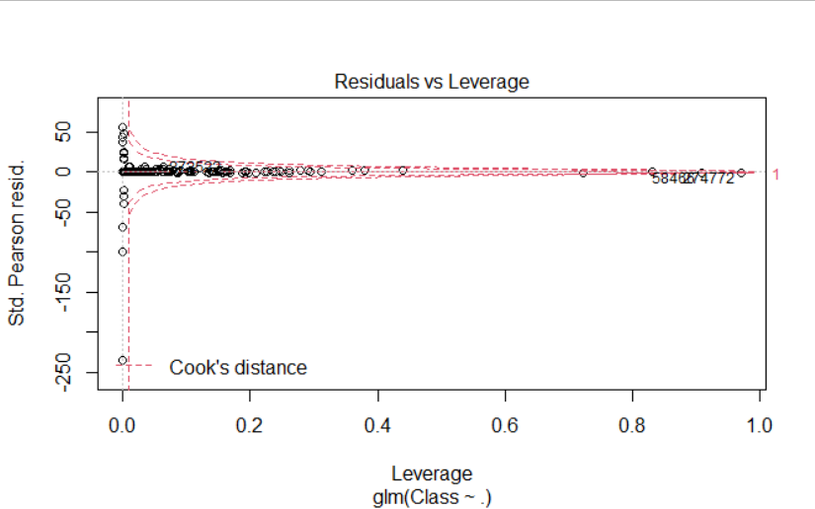

Slide 17
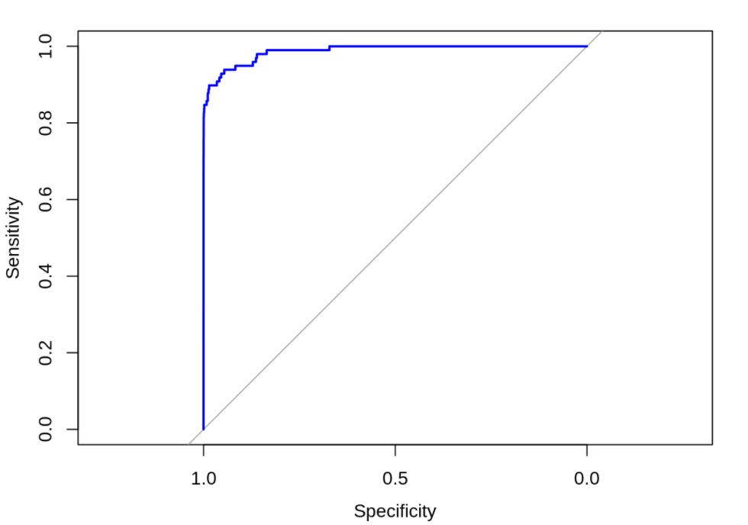

Slide 18
Fitting a Decision Tree Model
In this section, we will implement a decision tree algorithm. Decision trees to track the results of a decision. These results are essentially a consequence by which we can conclude to which class the object belongs. We will now implement our decision tree model and plot it using the rpart.plot () function. We will specifically use recursive division to plot the decision tree.

Slide 19
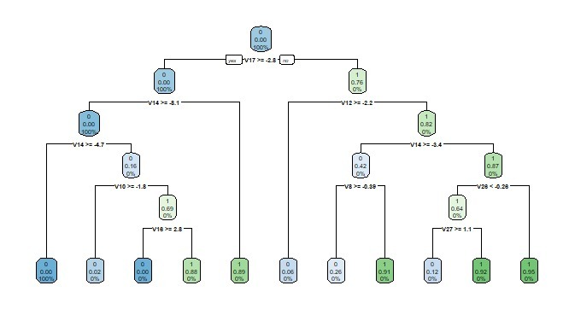

Slide 20
Fitting a Artificial Neural Network Model
We import the neuralnet package that would allow us to implement our ANNs. We therefore proceeded to plot it using the plot () function. Now, in the case of artificial neural networks, there is a range of values ​​between 1 and 0. We set a threshold at 0.5, that is, values ​​greater than 0.5 will correspond to 1 and the rest will be 0.

Slide 21
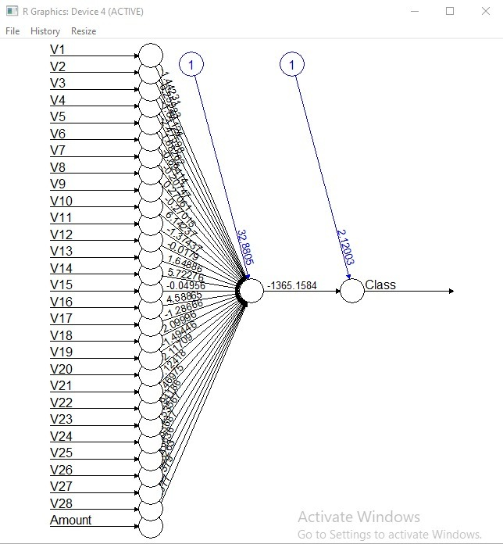

Slide 22
Fitting a Gradient Boosting Model
Gradient Boosting is a popular machine learning algorithm used to perform classification and regression tasks. This model includes several underlying ensemble models such as weak decision trees. These decision trees combine to form a strong gradient augmentation model. We will implement the gradient descent algorithm in our model

Slide 23
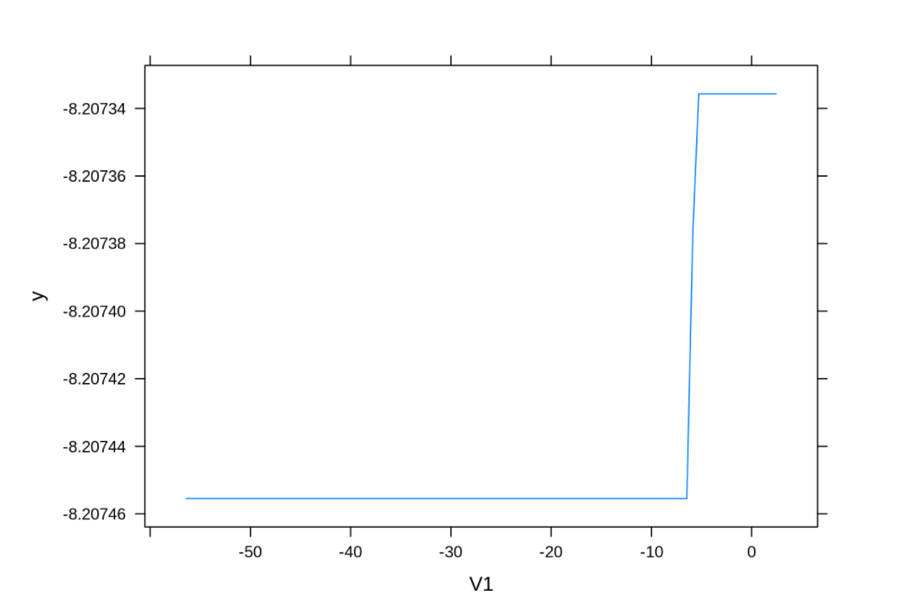
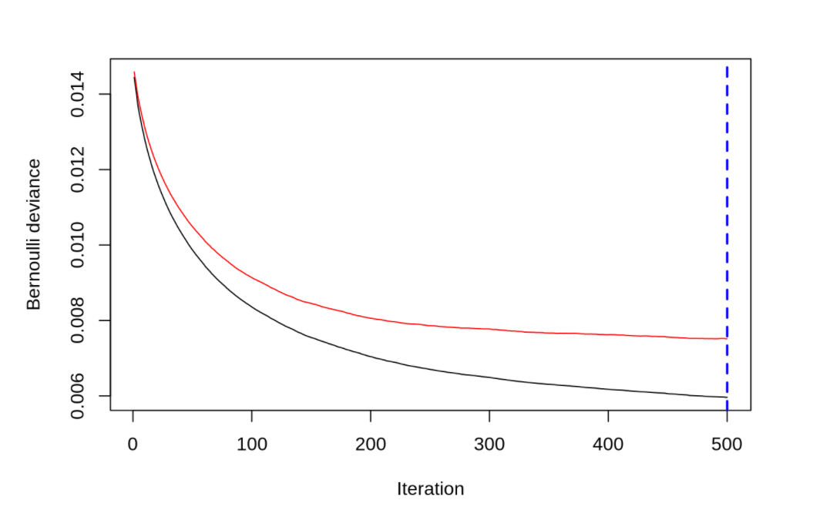

Slide 24
Summary
Finally, we learned how to use machine learning to develop our credit card fraud detection model. We implemented this model using a variety of ML algorithms and plotted the models' respective performance curves. We learned how to analyse and visualise data in order to distinguish fraudulent transactions from other types of data.

